Slide 1
Memory Management
By: Suvash Chandra Gautam
January 04, 2023

Slide 2
Memory Management
Memory management without swapping
Swapping
Virtual memory
Paging, Page replacement algorithms (FIFO, Optimal, LRU, LFU, NRU, Random, Clock, Second-chance)
Predicting page faults
Segmentation with paging

Slide 3
What is Memory Management?
Memory management in an operating system (OS) refers to the processes and techniques employed to handle the computer's memory resources effectively.
The primary goal of memory management is to provide a well-organized and efficient way for programs to access and use the computer's memory.
This involves allocation, deallocation, and tracking of memory space, ensuring that each program or process gets the required memory for execution without interfering with other programs. Here are some key aspects of memory management in an operating system:

Slide 4
Why Memory Management is Required?
Allocate and de-allocate memory before and after process execution.
To keep track of used memory space by processes.
To minimize fragmentation issues.
To proper utilization of main memory.
To maintain data integrity while executing of process.

Slide 5
What is memory Management?
Memory is the important part of the computer that is used to store the data. Its management is critical to the computer system because the amount of main memory available in a computer system is very limited.
At any time, many processes are competing for it. Moreover, to increase performance, several processes are executed simultaneously. For this, we must keep several processes in the main memory, so it is even more important to manage them effectively.

Slide 6
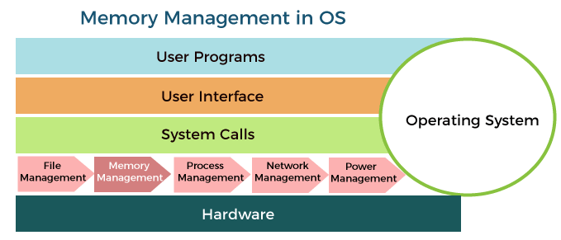

Slide 7
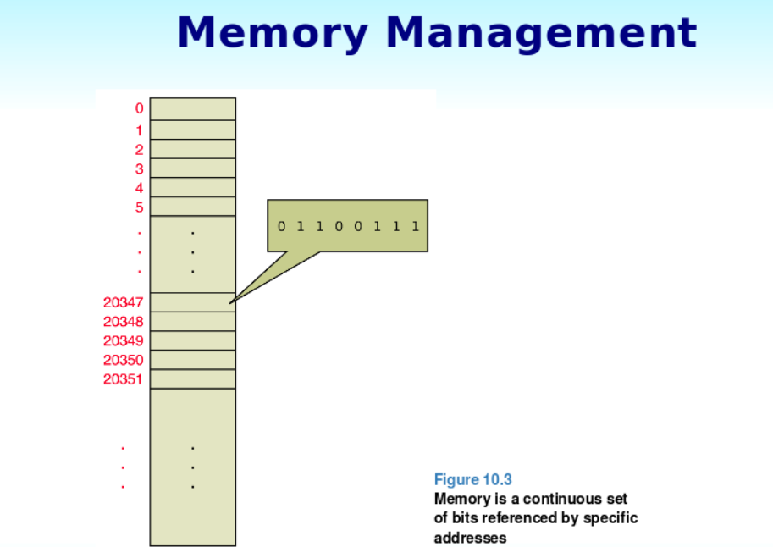

Slide 8
Role of Memory management
Memory manager is used to keep track of the status of memory locations, whether it is free or allocated. It addresses primary memory by providing abstractions so that software perceives a large memory is allocated to it.
Memory manager permits computers with a small amount of main memory to execute programs larger than the size or amount of available memory. It does this by moving information back and forth between primary memory and secondary memory by using the concept of swapping.
The memory manager is responsible for protecting the memory allocated to each process from being corrupted by another process. If this is not ensured, then the system may exhibit unpredictable behavior.
Memory managers should enable sharing of memory space between processes. Thus, two programs can reside at the same memory location although at different times.

Slide 9
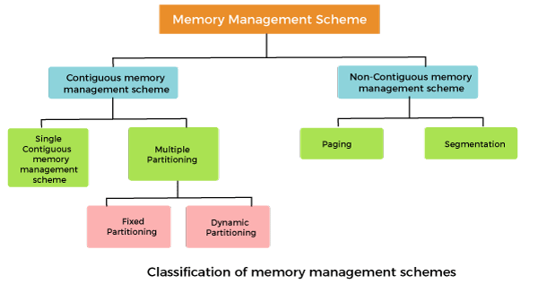
Memory Management Techniques:

Slide 10
Contiguous memory management schemes:
In a Contiguous memory management scheme, each program occupies a single contiguous block of storage locations, i.e., a set of memory locations with consecutive addresses.
Single contiguous memory management schemes:
The Single contiguous memory management scheme is the simplest memory management scheme used in the earliest generation of computer systems.
In this scheme, the main memory is divided into two contiguous areas or partitions.
The operating systems reside permanently in one partition, generally at the lower memory, and the user process is loaded into the other partition.

Slide 11
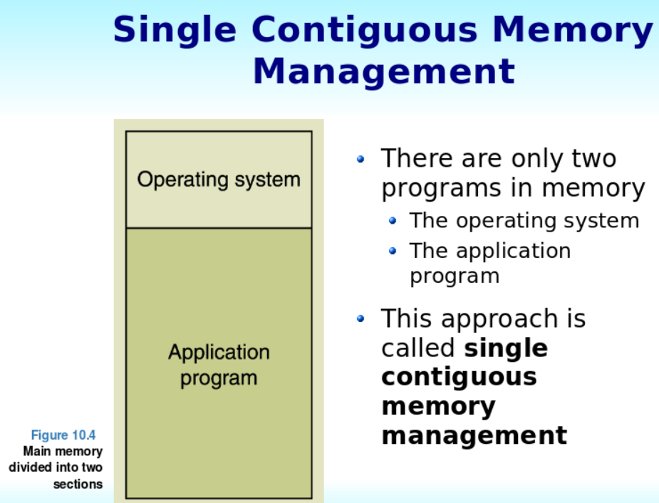
Single contiguous memory management schemes:

Slide 12
Advantages of Single contiguous memory management schemes:
Simple to implement.
Easy to manage and design.
In a Single contiguous memory management scheme, once a process is loaded, it is given full processor's time, and no other processor will interrupt it.

Slide 13
Multiple Partitioning:
Multiple partitioning is a memory management technique where the physical memory (RAM) is divided into several fixed-size or variable-size partitions.
Each partition can be assigned to a different process, allowing multiple processes to be loaded into memory concurrently.
This approach helps in efficient utilization of memory by accommodating multiple processes simultaneously.
There are two main types of multiple partitioning schemes:
Fixed Partitioning/Static:
Variable/Dynamic Partitioning:

Slide 14
Fixed/Static Partitioning
The main memory is divided into several fixed-sized partitions in a fixed partition memory management scheme or static partitioning. These partitions can be of the same size or different sizes.
Each partition can hold a single process.
The number of partitions determines the degree of multiprogramming, i.e., the maximum number of processes in memory.
These partitions are made at the time of system generation and remain fixed after that.

Slide 15
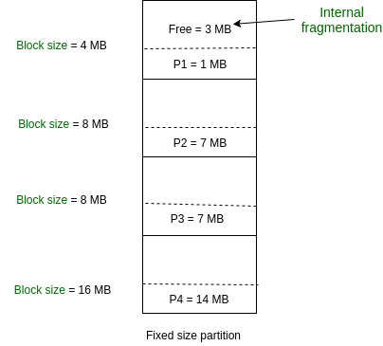
Fixed/Static Partitioning

Slide 16
Fixed/Static Partitioning Example
As illustrated in above figure, first process is only consuming 1MB out of 4MB in the main memory. Hence, Internal Fragmentation in first block is (4-1) = 3MB. Sum of Internal Fragmentation in every block = (4-1)+(8-7)+(8-7)+(16-14)= 3+1+1+2 = 7MB.
Suppose process P5 of size 7MB comes. But this process cannot be accommodated in spite of available free space because of contiguous allocation (as spanning is not allowed). Hence, 7MB becomes part of External Fragmentation.

Slide 17
Fixed/Static Partitioning
This is the oldest and simplest technique used to put more than one process in the main memory.
In this partitioning, the number of partitions (non-overlapping) in RAM is fixed but the size of each partition may or may not be the same.
As it is a contiguous allocation, hence no spanning is allowed. Here partitions are made before execution or during system configure.

Slide 18
Advantages
Simple to implement.
Easy to manage and design.

Slide 19
Internal and External Fragmentation
Internal fragmentation and external fragmentation are two types of memory wastage that can occur in a computer system due to memory allocation and deallocation processes.
Internal Fragmentation:
Definition: Internal fragmentation occurs when memory is allocated in fixed-size blocks, and the allocated memory block is larger than the actual size of the data being stored.
Example: Consider a system with fixed-size memory blocks of 100 units. If a process requires 80 units of memory, it will be allocated an entire block of 100 units. The remaining 20 units within the block are wasted due to internal fragmentation.

Slide 20
Disadvantages of Fixed Partitioning –
Internal Fragmentation:
Main memory use is inefficient. Any program, no matter how small, occupies an entire partition. This can cause internal fragmentation.
External Fragmentation:
The total unused space (as stated above) of various partitions cannot be used to load the processes even though there is space available but not in the contiguous form (as spanning is not allowed).

Slide 21
Internal and External Fragmentation
Definition: External fragmentation occurs when free memory is scattered in small, non-contiguous chunks throughout the system, making it challenging to allocate a contiguous block of memory for a process.
Explanation: In systems with variable-size memory allocation (such as dynamic partitioning or dynamic page allocation), memory blocks are of varying sizes. As processes are loaded and removed, free memory becomes fragmented into smaller pieces.
Even if the total free memory is sufficient to accommodate a process, it may be scattered in such a way that finding a single contiguous block becomes difficult.

Slide 22
Internal and External Fragmentation
Example: Consider a system with 300 units of free memory, divided into three non-contiguous chunks of 100, 50, and 150 units. If a process requires 200 units of contiguous memory, it cannot be accommodated, leading to external fragmentation.
Impact: External fragmentation can result in wasted memory, as free memory may be too fragmented to be effectively utilized. This fragmentation can also hinder the performance of memory allocation algorithms.

Slide 23
Dynamic Partitioning
Dynamic partitioning is a memory management technique where the physical memory (RAM) is divided into variable-sized partitions to accommodate processes with different memory requirements.
Unlike fixed partitioning, where all partitions are of the same size, dynamic partitioning allows the creation of partitions that match the exact size needed by each process.
It is a part of the Contiguous allocation technique. It is used to alleviate the problem faced by Fixed Partitioning. In contrast with fixed partitioning, partitions are not made before the execution or during system configuration

Slide 24
Dynamic Partitioning
Initially, RAM is empty and partitions are made during the run-time according to the process’s need instead of partitioning during system configuration.
The size of the partition will be equal to the incoming process.
The partition size varies according to the need of the process so that internal fragmentation can be avoided to ensure efficient utilization of RAM.
The number of partitions in RAM is not fixed and depends on the number of incoming processes and the Main Memory’s size.

Slide 25
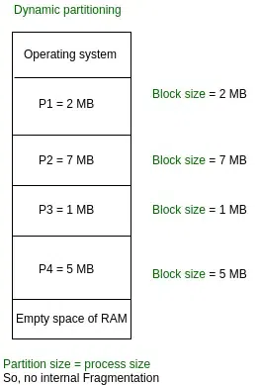
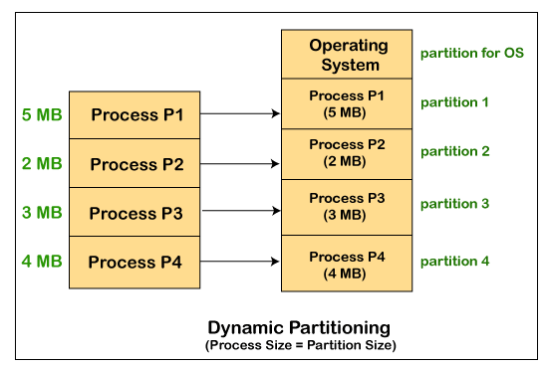

Slide 26
Advantages of Variable(Dynamic) Partitioning
No Internal Fragmentation: In variable Partitioning, space in the main memory is allocated strictly according to the need of the process, hence there is no case of internal fragmentation. There will be no unused space left in the partition.
No restriction on the Degree of Multiprogramming: More processes can be accommodated due to the absence of internal fragmentation. A process can be loaded until the memory is empty.

Slide 27
Logical and Physical Address Space
Logical Address Space: An address generated by the CPU is known as a “Logical Address”. It is also known as a Virtual address. Logical address space can be defined as the size of the process. A logical address can be changed.
Physical Address Space: An address seen by the memory unit (i.e. the one loaded into the memory address register of the memory) is commonly known as a “Physical Address”. A Physical address is also known as a Real address.
The set of all physical addresses corresponding to these logical addresses is known as Physical address space. A physical address is computed by MMU.

Slide 28
Logical and Physical Address Space
A logical address is generated by CPU while a program is running. Since a logical address does not physically exists it is also known as a virtual address. This address is used as a reference by the CPU to access the actual physical memory location.
There is a hardware device called Memory-Management Unit is used for mapping logical address to its corresponding physical address.
A physical address identifies the physical location of a specific data element in memory. The user never directly deals with the physical address but can determine the physical address by its corresponding logical address.
The user program generates the logical address and believes that the program is running in this logical address space, but the program needs physical memory for its execution, therefore, the logical address must be mapped to the physical address by the MMU before the addresses are used. The term physical address space is used for all physical addresses corresponding to the logical addresses in a logical address space.

Slide 29
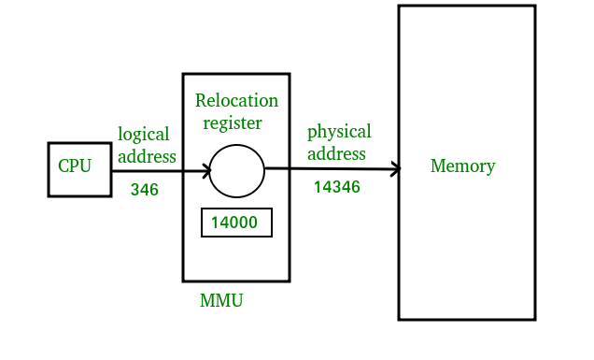
Logical and Physical Address Space

Slide 30
Difference between logical address and Physical address
Parameter | LOGICAL ADDRESS | PHYSICAL ADDRESS
Basic | generated by CPU | location in a memory unit
Address Space | Logical Address Space is set of all logical addresses generated by CPU in reference to a program. | Physical Address is set of all physical addresses mapped to the corresponding logical addresses.
Visibility | User can view the logical address of a program. | User can never view physical address of program.
Generation | generated by the CPU | Computed by MMU
Access | The user can use the logical address to access the physical address. | The user can indirectly access physical address but not directly.
Editable | Logical address can be change. | Physical address will not change.
Also called | virtual address. | real address.

Slide 31
Static and Dynamic Loading
Loading a process into the main memory is done by a loader. There are two different types of loading :
Static Loading: Static Loading is basically loading the entire program into a fixed address. It requires more memory space.
Dynamic Loading: The entire program and all data of a process must be in physical memory for the process to execute. So, the size of a process is limited to the size of physical memory.
To gain proper memory utilization, dynamic loading is used. In dynamic loading, a routine is not loaded until it is called. All routines are residing on disk in a relocatable load format. One of the advantages of dynamic loading is that the unused routine is never loaded. This loading is useful when a large amount of code is needed to handle it efficiently.

Slide 32
Swapping
When a process is executed it must have resided in memory. Swapping is a process of swapping a process temporarily into a secondary memory from the main memory, which is fast compared to secondary memory.
A swapping allows more processes to be run and can be fit into memory at one time. The main part of swapping is transferred time and the total time is directly proportional to the amount of memory swapped.
Swapping is also known as roll-out, or roll because if a higher priority process arrives and wants service, the memory manager can swap out the lower priority process and then load and execute the higher priority process.
After finishing higher priority work, the lower priority process swapped back in memory and continued to the execution process.

Slide 33
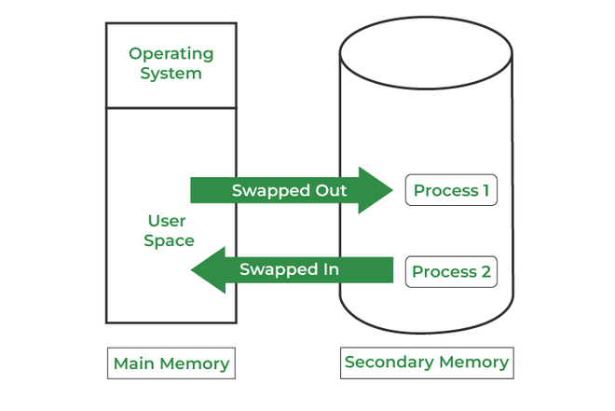

Slide 34
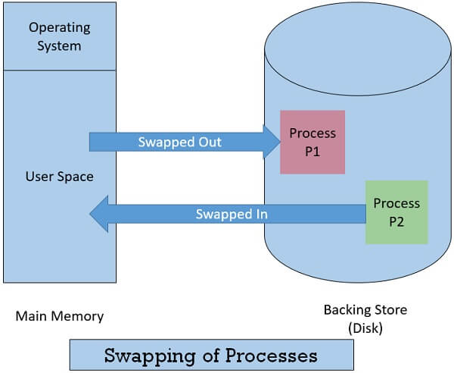

Slide 35
Swap-In & Swap Out:
Swapping has been subdivided into two concepts: swap-in and swap-out.
Swap-out is a technique for moving a process from RAM to the hard disc.
Swap-in is a method of transferring a program from a hard disc to main memory, or RAM.

Slide 36
Advantages:
If there is low main memory so some processes may has to wait for much long but by using swapping process do not have to wait long for execution on CPU.
It utilize the main memory.
Using only single main memory, multiple process can be run by CPU using swap partition.
The concept of virtual memory start from here and it utilize it in better way.
This concept can be useful in priority based scheduling to optimize the swapping process.

Slide 37
Disadvantages:
If there is low main memory resource and user is executing too many processes and suddenly the power of system goes off there might be a scenario where data get erase of the processes which are took parts in swapping.
Chances of number of page faults occur
Low processing performance.

Slide 38
Virtual memory
Virtual Memory is a storage mechanism which offers user an illusion of having a very big main memory.
It is done by treating a part of secondary memory as the main memory. In Virtual memory, the user can store processes with a bigger size than the available main memory.
Therefore, instead of loading one long process in the main memory, the OS loads the various parts of more than one process in the main memory. Virtual memory is mostly implemented with demand paging and demand segmentation.

Slide 39
Why Need Virtual Memory?
Whenever your computer doesn’t have space in the physical memory it writes what it needs to remember to the hard disk in a swap file as virtual memory.
If a computer running Windows needs more memory/RAM, then installed in the system, it uses a small portion of the hard drive for this purpose.

Slide 40
For example
Let’s assume that an OS requires 300 MB of memory to store all the running programs. However, there’s currently only 50 MB of available physical memory stored on the RAM.

Slide 41
For Example
The OS will then set up 250 MB of virtual memory and use a program called the Virtual Memory Manager(VMM) to manage that 250 MB.
So, in this case, the VMM will create a file on the hard disk that is 250 MB in size to store extra memory that is required.
The OS will now proceed to address memory as it considers 300 MB of real memory stored in the RAM, even if only 50 MB space is available.
It is the job of the VMM to manage 300 MB memory even if just 50 MB of real memory space is available.

Slide 42
Advantages of Virtual Memory
More processes may be maintained in the main memory: Because we are going to load only some of the pages of any particular process, there is room for more processes. This leads to more efficient utilization of the processor because it is more likely that at least one of the more numerous processes will be in the ready state at any particular time.
A process may be larger than all of the main memory: One of the most fundamental restrictions in programming is lifted. A process larger than the main memory can be executed because of demand paging. The OS itself loads pages of a process in the main memory as required.

Slide 43
Advantages of Virtual Memory
It allows greater multiprogramming levels by using less of the available (primary) memory for each process.
It has twice the capacity for addresses as main memory.
It makes it possible to run more applications at once.
Users are spared from having to add memory modules when RAM space runs out, and applications are liberated from shared memory management.

Slide 44
Advantages of Virtual Memory
When only a portion of a program is required for execution, speed has increased.
Memory isolation has increased security.
It makes it possible for several larger applications to run at once.
Memory allocation is comparatively cheap.
It doesn’t require outside fragmentation.
It is efficient to manage logical partition workloads using the CPU.
Automatic data movement is possible.

Slide 45
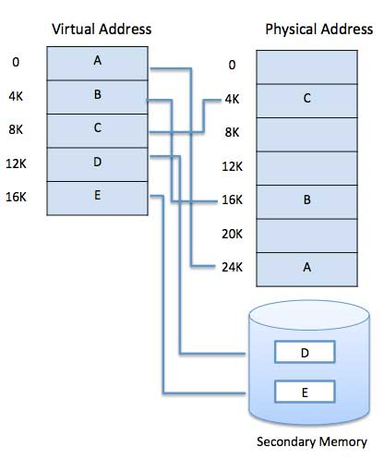
Virtual Memory

Slide 46
Virtual Memory
Virtual memory is commonly implemented by demand paging. It can also be implemented in a segmentation system. Demand segmentation can also be used to provide virtual memory.
Demand Paging: A demand paging system is quite similar to a paging system with swapping where processes reside in secondary memory and pages are loaded only on demand, not in advance.
When a context switch occurs, the operating system does not copy any of the old program’s pages out to the disk or any of the new program’s pages into the main memory Instead, it just begins executing the new program after loading the first page and fetches that program’s pages as they are referenced.

Slide 47
Non-Contiguous memory management schemes:
In a Non-Contiguous memory management scheme, the program is divided into different blocks and loaded at different portions of the memory that need not necessarily be adjacent to one another.
This scheme can be classified depending upon the size of blocks and whether the blocks reside in the main memory or not.

Slide 48
What is Paging?
Paging is a technique that eliminates the requirements of contiguous allocation of main memory.
In this, the main memory is divided into fixed-size blocks of physical memory called frames.
The size of a frame should be kept the same as that of a page to maximize the main memory and avoid external fragmentation.

Slide 49
What is Paging?
Paging is a fixed size partitioning scheme.
In paging, secondary memory and main memory are divided into equal fixed size partitions.
The partitions of secondary memory are called as pages.
The partitions of main memory are called as frames.
Each process is divided into parts where size of each part is same as page size.
The size of the last part may be less than the page size.
The pages of process are stored in the frames of main memory depending upon their availability.

Slide 50
Paging
The advantages of paging are-
It allows to store parts of a single process in a non-contiguous fashion.
It solves the problem of external fragmentation.
Disadvantages-
The disadvantages of paging are-
It suffers from internal fragmentation.
There is an overhead of maintaining a page table for each process.
The time taken to fetch the instruction increases since now two memory accesses are required.
To gain better understanding about Paging,

Slide 51
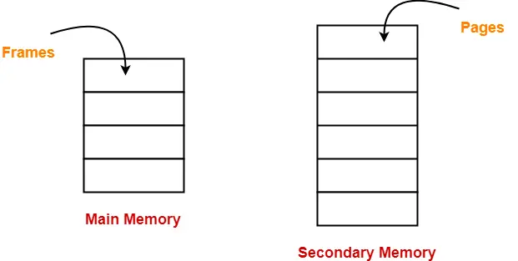
Pages and Frames

Slide 52
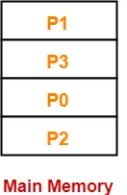
Examples:
Consider a process is divided into 4 pages P₀, P₁, P₂ and P₃.
Depending upon the availability, these pages may be stored in the main memory frames in a non-contiguous fashion as shown-

Slide 53
Advantages of paging:
Pages reduce external fragmentation.
Simple to implement.
Memory efficient.
Due to the equal size of frames, swapping becomes very easy.
It is used for faster access of data.

Slide 54
What is Segmentation?
Segmentation is a technique that eliminates the requirements of contiguous allocation of main memory.
In this, the main memory is divided into variable-size blocks of physical memory called segments. It is based on the way the programmer follows to structure their programs.
With segmented memory allocation, each job is divided into several segments of different sizes, one for each module.
Functions, subroutines, stack, array, etc., are examples of such modules.

Slide 55
Translating Logical Address into Physical Address-
CPU always generates a logical address.
A physical address is needed to access the main memory.
Following steps are followed to translate logical address into physical address-
Step-01:
CPU generates a logical address consisting of two parts-
Page Number
Page Offset

Slide 56
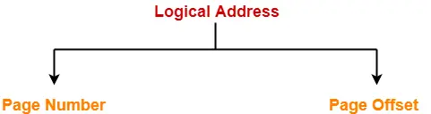
Translating Logical Address into Physical Address-
Page Number specifies the specific page of the process from which CPU wants to read the data.
Page Offset specifies the specific word on the page that CPU wants to read.

Slide 57
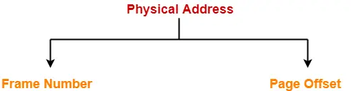
Translating Logical Address into Physical Address-
Step-02:
For the page number generated by the CPU,
Page Table provides the corresponding frame number (base address of the frame) where that page is stored in the main memory.
Step-03:
The frame number combined with the page offset forms the required physical address.

Slide 58
Translating Logical Address into Physical Address-
Frame number specifies the specific frame where the required page is stored.
Page Offset specifies the specific word that has to be read from that page.

Slide 59
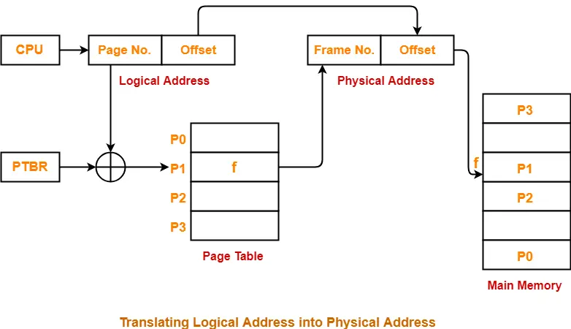
Translating Logical Address into Physical Address-

Slide 60
Page Replacement Algorithm
In an operating system that uses paging for memory management, a page replacement algorithm is needed to decide which page needs to be replaced when a new page comes in.
Page Fault: A page fault happens when a running program accesses a memory page that is mapped into the virtual address space but not loaded in physical memory.
Since actual physical memory is much smaller than virtual memory, page faults happen.
In case of a page fault, Operating System might have to replace one of the existing pages with the newly needed page.
Different page replacement algorithms suggest different ways to decide which page to replace. The target for all algorithms is to reduce the number of page faults.

Slide 61
Page Replacement Algorithm
** Page Fault is the condition in which a running process refers to a page that is not loaded in the main memory.
Page Replacement Algorithm decides which page to remove, also called swap out when a new page needs to be loaded into the main memory. Page Replacement happens when a requested page is not present in the main memory and the available space is not sufficient for allocation to the requested page.
A Page Replacement Algorithm is required to decide which page needs to be replaced.
A good page replacement algorithm is one that minimizes the number of page faults.

Slide 62
FIFO (First-In-First-Out):
This algorithm replaces the oldest page in memory when a page fault occurs. It keeps track of all pages in memory in a queue and when a page fault occurs, the page at the front of the queue is removed and a new page is added to the back of the queue. When a page needs to be replaced page in the front of the queue is selected for removal.
A page replacement algorithm determines which page to replace in order to allocate memory for the new page. A flowchart can be used to summarize the phases of a page replacement:

Slide 63
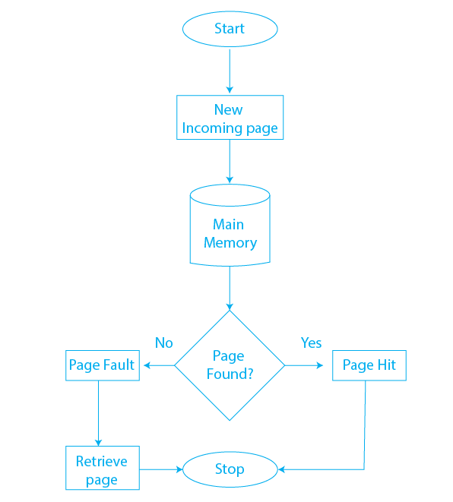

Slide 64
FIFO Page Replacement Algorithm
The FIFO page replacement algorithm follows these steps:
Step 1: Initialize a queue to keep track of the pages in memory.
Step 2: When a page fault occurs and a page needs to be replaced, the page at the front of the queue is selected for replacement.
Step 3: The page that is being replaced is removed from memory and the new page is added to the back of the queue.
Step 4: This process continues each time a page fault occurs and a page needs to be replaced.

Slide 65
Example of FIFO-Problem-01:
A system uses 3 page frames for storing process pages in main memory. It uses the First in First out (FIFO) page replacement policy. Assume that all the page frames are initially empty. What is the total number of page faults that will occur while processing the page reference string given below-
Pages: 3,2,1,3,4,1,6,2,4,3,4,2,1,4,5,2,1,3,4
Also calculate the hit ratio and miss ratio

Slide 66
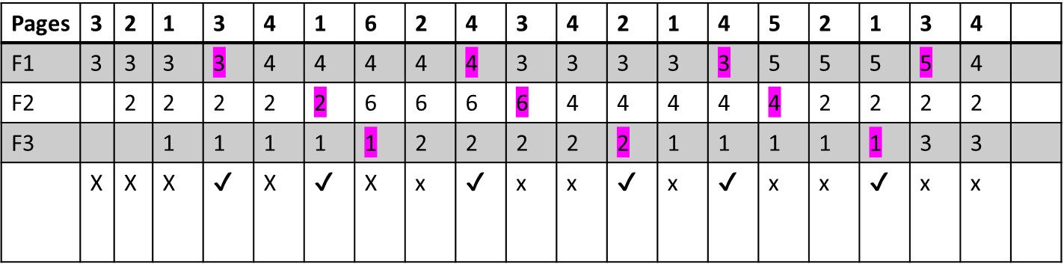
Example of FIFO-Problem-01:
Total number of frame=3(f1,f2,f3)
Total No of pages: 3,2,1,3,4,1,6,2,4,3,4,2,1,4,5,2,1,3,4
Step 1: Page 3 is not available(Page Fault) in main memory. Just load page 3 into main memory. It means the requested page is not found in physical memory.

Slide 67
Pages | 3 | 2 | 1 | 3 | 4 | 1 | 6 | 2 | 4 | 3 | 4 | 2 | 1 | 4 | 5 | 2 | 1 | 3 | 4
F1 | 3 | 3 | 3 | 3 | 4 | 4 | 4 | 4 | 4 | 3 | 3 | 3 | 3 | 3 | 5 | 5 | 5 | 5 | 4
F2 |  | 2 | 2 | 2 | 2 | 2 | 6 | 6 | 6 | 6 | 4 | 4 | 4 | 4 | 4 | 2 | 2 | 2 | 2
F3 |  |  | 1 | 1 | 1 | 1 | 1 | 2 | 2 | 2 | 2 | 2 | 1 | 1 | 1 | 1 | 1 | 3 | 3
 | X | X | X | ✔ | X | ✔ | X | x | ✔ | x | x | ✔ | x | ✔ | x | x | ✔ | x | x

Slide 68
Operations
The page 3 is not available in main memory, so it is loaded in main memory in frame F1
The Page 2 is not available in main memory(page fault), so it is loaded into Main memory in frame F2
The page 1 is also not available in memory . So, it is loaded in main memory in frame 3.
The page 3 is replaced by 4.
The page 2 is replaced by 6.
The page 1 is replaced by 2.

Slide 69
Operations
The page 4 is replaced by 3.
The page 6 is replaced by 4.
The page 2 is replaced by 1.
The page 3 is replaced by 5.
The page 4 is replaced by 2.
The page 1 is replaced by 3.
Finally, the page 5 is replaced by 4

Slide 70
Operations
No of hit(h)=6
No of page fault/Miss=13
Hit ration(HR)=No of hit/No of miss+ no of miss=6/6+13=6/19
Miss ratio(MR)=13/19

Slide 71
Problem:02
A system uses 3 page frames for storing process pages in main memory. It uses the First in First out (FIFO) page replacement policy. Assume that all the page frames are initially empty. What is the total number of page faults that will occur while processing the page reference string given below-
4 , 7, 6, 1, 7, 6, 1, 2, 7, 2
Also calculate the hit ratio and miss ratio.

Slide 72
Pages | 4 | 7 | 6 | 1 | 7 | 6 | 1 | 2 | 7 | 2
F1 | 4 | 4 | 4 | 1 | 1 | 1 | 1 | 1 | 1 | 1
F2 |  | 7 | 7 | 7 | 7 | 7 | 7 | 2 | 2 | 2
F3 |  |  | 6 | 6 | 6 | 6 | 6 | 6 | 7 | 7
 | X | X | X | x | ✔ | ✔ | x | x | ✔ | ✔

Slide 73
Operations:
Total number of references = 10
Total number of page faults occurred/No of Miss=6
Calculating Hit ratio-
Total number of page hits
= Total number of references – Total number of page misses or page faults
= 10 – 6
= 4

Slide 74
Operations
Thus, Hit ratio
= Total number of page hits / Total number of references
= 4 / 10
= 0.4 or 40%
Calculating Miss ratio-
Total number of page misses or page faults = 6
Thus, Miss ratio
= Total number of page misses / Total number of references
= 6 / 10
= 0.6 or 60%

Slide 75
Advantages of the FIFO Algorithm
Simple to implement: FIFO is a very simple algorithm to implement, as it only requires a basic data structure like a queue to keep track of the items.
Low overhead: Since FIFO only requires a simple data structure and does not require any additional information to be stored, it has low overhead.
Easy to understand: FIFO is easy to understand, as it only uses a first-in, first-out approach, and does not require any complex calculations.
Predictable: FIFO is predictable, as the item that was brought in first will be the first one to be replaced.
Predictable behavior: The algorithm has a predictable behavior, so it can be easily used in systems where predictability is important.
Low complexity: FIFO is a low-complexity algorithm and requires minimal computational power.

Slide 76
Drawbacks of the FIFO Algorithm
Belady’s Anomaly: FIFO can lead to Belady’s Anomaly, where the number of page faults can increase as the number of frames increases, under certain circumstances.
Not effective for workloads with a spatial locality: If a workload has a spatial locality, where pages that are used together are likely to be used again soon, FIFO does not perform well, as it does not take into account how recently or frequently a page has been used.

Slide 77
Page Fault Terminology
There are various page fault terminologies in the operating system. Some terminologies of page fault are as follows:
1. Page Hit
When the CPU attempts to obtain a needed page from main memory and the page exists in main memory (RAM), it is referred to as a "PAGE HIT".
2. Page Miss
If the needed page has not existed in the main memory (RAM), it is known as "PAGE MISS".

Slide 78
Problem 3
Example-2: Consider the page references 7, 0, 1, 2, 0, 3, 0, 4, 2, 3, 0, 3, 2, 3 with 4 page frame. Find number of page fault.

Slide 79
What is LRU Page Replacement Algorithm?
The LRU stands for the Least Recently Used. It keeps track of page usage in the memory over a short period of time.
It works on the concept that pages that have been highly used in the past are likely to be significantly used again in the future.
It removes the page that has not been utilized in the memory for the longest time.
LRU is the most widely used algorithm because it provides fewer page faults than the other methods.
Least Recently Used (LRU) algorithm is a page replacement technique used for memory management. According to this method, the page which is least recently used is replaced. Therefore, in memory, any page that has been unused for a longer period of time than the others is replaced.

Slide 80
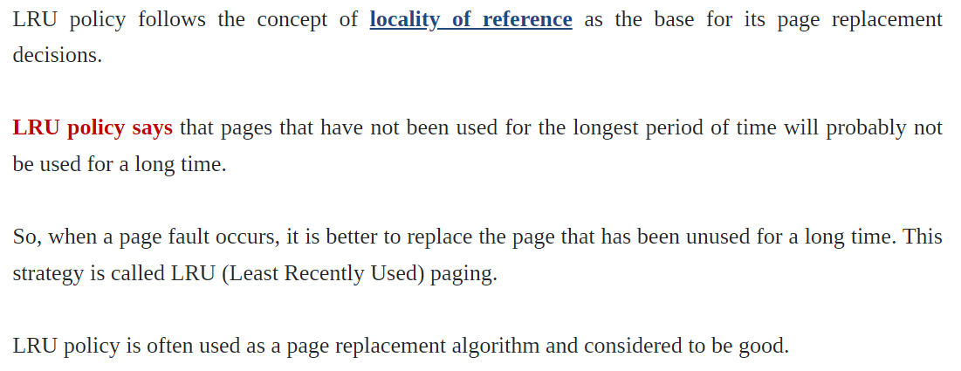
What is LRU Page Replacement Algorithm?

Slide 81
Problem One
FS | 3 | 2 | 1 | 3 | 4 | 1 | 6 | 2 | 4 | 3 | 4 | 2 | 1 | 4 | 5 | 2 | 1 | 3 | 4
F1 | 3 | 3 | 3 | 3 | 3 | 3 | 6 | 6 | 6 | 3 | 3 | 3 | 1 | 1 | 1 | 2 | 2 | 2 | 4
F2 |  | 2 | 2 | 2 | 4 | 4 | 4 | 2 | 2 | 2 | 2 | 2 | 2 | 2 | 5 | 5 | 5 | 3 | 3
F3 |  |  | 1 | 1 | 1 | 1 | 1 | 1 | 4 | 4 | 4 | 4 | 4 | 4 | 4 | 4 | 1 | 1 | 1
 | M | M | M | H | M | H | M | M | M | M | H | H | M | H | M | M | M | M | M

Slide 82
What is LRU Page Replacement Algorithm?
Page fault/Miss=14
No of Page Hit= 5
Hit Ratio=5/19
Miss Ratio=1-5/19

Slide 83
Problem -02
References String: 7,0,1, 2,0,3, 0,4,2,3,0,3,2,1,2,0,1,7,0,1
Find the Miss and Hit Ratio by using LRU.
Fundamental Concept: Observe the left most digit at every step and replaced this by new page.

Slide 84
Problem One
FS | 7 | 0 | 1 | 2 | 0 | 3 | 0 | 4 | 2 | 3 | 0 | 3 | 2 | 1 | 2 | 0 | 1 | 7 | 0 | 1
F1 | 7 | 7 | 7 | 7 | 7 | 3 | 3 | 3 | 3 | 3 | 3 | 3 | 3 | 1 | 1 | 1 | 1 | 7 | 7 | 7
F2 |  | 0 | 0 | 0 | 0 | 0 | 0 | 0 | 0 | 0 | 0 | 0 | 0 | 0 | 0 | 0 | 0 | 0 | 0 | 0
F3 |  |  | 1 | 1 | 1 | 1 | 1 | 4 | 4 | 4 | 4 | 4 | 4 | 1 | 1 | 1 | 1 | 1 | 1 | 1
F4 |  |  |  | 2 | 2 | 2 | 2 | 2 | 2 | 2 | 2 | 2 | 2 | 2 | 2 | 2 | 2 | 2 | 2 | 2
 | M | M | M | M | H | M | H | M | H | H | H | H | H | M | H | H | H | M | H | H

Slide 85
Operations:
Page fault=8
Hits=12
Hit Ratio=12/20
Miss Ratio=8/20

Slide 86
Problem 3
5 0 1 2 0 3 2 0 3 4 1 0 5 0 4 3 2 1 2 0 1
Find the number of page faults when the LRU page replacement policy is used. Also, consider the page frame size to be three.
Solution:
Reference String:
5 0 1 2 0 3 2 0 3 4 1 0 5 0 4 3 2 1 2 0 1

Slide 87
String | 5 | 0 | 1 | 2 | 0 | 3 | 2 | 0 | 3 | 4 | 1 | 0 | 5 | 0 | 4 | 3 | 2 | 1 | 2 | 0 | 1
F1 | 5 | 5 | 5 | 2 | 2 | 2 | 2 | 2 | 2 | 4 | 4 | 4 | 5 | 5 | 5 | 3 | 3 | 3 | 3 | 0 | 0
F2 |  | 0 | 0 | 0 | 0 | 0 | 0 | 0 | 0 | 0 | 1 | 1 | 1 | 1 | 4 | 4 | 4 | 1 | 1 | 1 | 1
F3 |  |  | 1 | 1 | 1 | 3 | 3 | 3 | 3 | 3 | 3 | 0 | 0 | 0 | 0 | 0 | 2 | 2 | 2 | 2 | 2
Miss/Hit | M | M | M | M | H | M | H | H | H | M | M | M | M | H | M | M | M | M | H | M | H

Slide 88
Operation:
Total number of page faults or page misses = 14
We know that,
Total number of page hits = Total number of reference strings - Total number of page faults
Total number of page hits = 21 - 14 = 7
Page fault probability = Total number of page faults / Total number of reference strings
Page fault probability = 14/21 = 0.67
Page fault percentage = Total number of page faults / Total number of reference strings * 100
Page fault percentage = 14/21*100 = 67%

Slide 89
LRU Page Replacement Algorithm
A system uses 3 page frames for storing process pages in main memory. It uses the Least Recently Used (LRU) page replacement policy. Assume that all the page frames are initially empty. What is the total number of page faults that will occur while processing the page reference string given below-
4 , 7, 6, 1, 7, 6, 1, 2, 7, 2
Also calculate the hit ratio and miss ratio.

Slide 90
Optimal Page Replacement Algorithm
"Optimal page replacement algorithm" is the most desirable page replacement algorithm that we use for replacing pages.
This algorithm replaces the page whose demand in the future is less as compared to other pages from frames (secondary memory).
The replacement occurs when the page fault appears. The purpose of this algorithm is to minimize the number of page faults.
Also, one of the most famous abnormalities in the paging technique is "Belady's Anomaly", which is least seen in this algorithm.

Slide 91
Optimal Page Replacement Algorithm
This algorithm replaces the page that will not be referred by the CPU in future for the longest time.
It is practically impossible to implement this algorithm.
This is because the pages that will not be used in future for the longest time can not be predicted.
However, it is the best known algorithm and gives the least number of page faults.
Hence, it is used as a performance measure criterion for other algorithms.

Slide 92
Problem
Problem: 7,0,1,2,0,3,0,4,2,3,0,3,2,1,2,0,1,7,0,1
S | 7 | 0 | 1 | 2 | 0 | 3 | 0 | 4 | 2 | 3 | 0 | 3 | 2 | 1 | 2 | 0 | 1 | 7 | 0 | 1
F4 |  |  |  | 2 | 2 | 2 | 2 | 2 | 2 | 2 | 2 | 2 | 2 | 2 | 2 | 2 | 2 | 2 | 2 | 2
F3 |  |  | 1 | 1 | 1 | 1 | 1 | 4 | 4 | 4 | 4 | 4 | 4 | 1 | 1 | 1 | 1 | 1 | 1 | 1
F2 |  | 0 | 0 | 0 | 0 | 0 | 0 | 0 | 0 | 0 | 0 | 0 | 0 | 0 | 0 | 0 | 0 | 0 | 0 | 0
F1 | 7 | 7 | 7 | 7 | 7 | 3 | 3 | 3 | 3 | 3 | 3 | 3 | 3 | 3 | 3 | 3 | 3 | 7 | 7 | 7
 | M | M | M | M | H | M | H | M | H | H | H | H | H | M | H | H | H | M | H | H

Slide 93
Operation
Replace the page which is not used in longest dimension of time in future.
Replaced by the last number in the list.
No of hits=12
No of Miss=8
Hit Ratio=?
Miss Ratio=?

Slide 94
Problem-Class Work
Consider the reference string 6, 1, 1, 2, 0, 3, 4, 6, 0, 2, 1, 2, 1, 2, 0, 3, 2, 1, 4, 0 for a memory with three frames and calculate number of page faults by using OPTIMAL Page replacement algorithms.
Points to Remember
Page Not Found - - - > Page Fault
Page Found - - - > Page Hit
Reference String:

Slide 95
 | 1 | 2 | 3 | 4 | 5 | 6 | 7 | 8 | 9 | 10 | 11 | 12 | 13 | 14 | 15 | 16 | 17 | 18 | 19 | 20
S | 6 | 1 | 1 | 2 | 0 | 3 | 4 | 6 | 0 | 2 | 1 | 2 | 1 | 2 | 0 | 3 | 2 | 1 | 4 | 0
F3 |  |  |  | 2 | 2 | 2 | 4 | 4 | 4 | 4 | 1 | 1 | 1 | 1 | 1 | 1 | 1 | 1 | 1 | 1
F2 |  | 1 | 1 | 1 | 0 | 0 | 0 | 0 | 0 | 0 | 0 | 0 | 0 | 0 | 0 | 3 | 3 | 1 | 1 | 1
F1 | 6 | 6 | 6 | 6 | 6 | 6 | 6 | 6 | 6 | 2 | 2 | 2 | 2 | 2 | 2 | 2 | 2 | 2 | 4 | 0
 | M | M | H | M | M | M | M | H | H | M | M | H | H | H | H | M | H | M | M | M

Slide 96
Operation:
Number of Page Hits = 8
Number of Page Faults = 12
The Ratio of Page Hit to the Page Fault = 8 : 12 - - - > 2 : 3 - - - > 0.66
The Page Hit Percentage = 8 *100 / 20 = 40%
The Page Fault Percentage = 100 - Page Hit Percentage = 100 - 40 = 60%

Slide 97
References
https://afteracademy.com/blog/what-are-the-page-replacement-algorithms/
https://www.javatpoint.com/page-fault-handling-in-operating-system
https://www.geeksforgeeks.org/page-replacement-algorithms-in-operating-systems/

